Slide 1
Machine Learning DASC 522
Classical Classification
Dr. Torrey Wagner

Slide 2
Overview
Big Picture
Classification Fundamentals
Logistic Regression
Linear Discriminant Analysis
Quadratic Discriminant Analysis
Error
Model Building with Python Examples

Slide 3
Overview
Big Picture
Classification Fundamentals
Logistic Regression
Linear Discriminant Analysis
Quadratic Discriminant Analysis
Error
Model Building with Python Examples

Slide 4
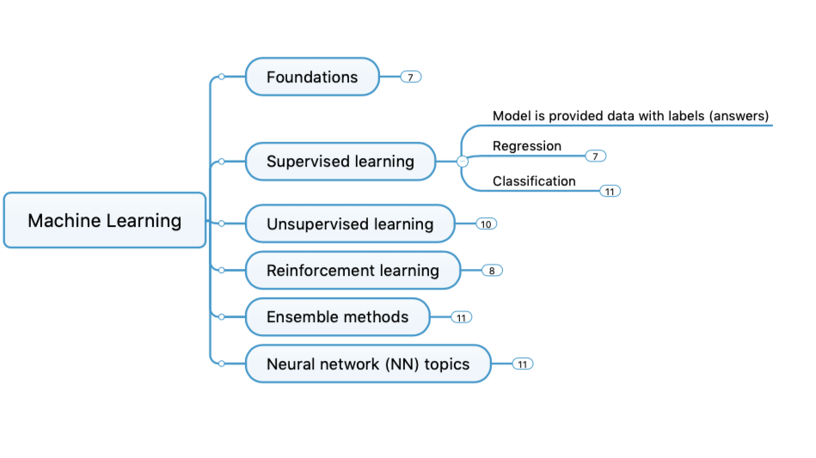
Concept Map

Slide 5
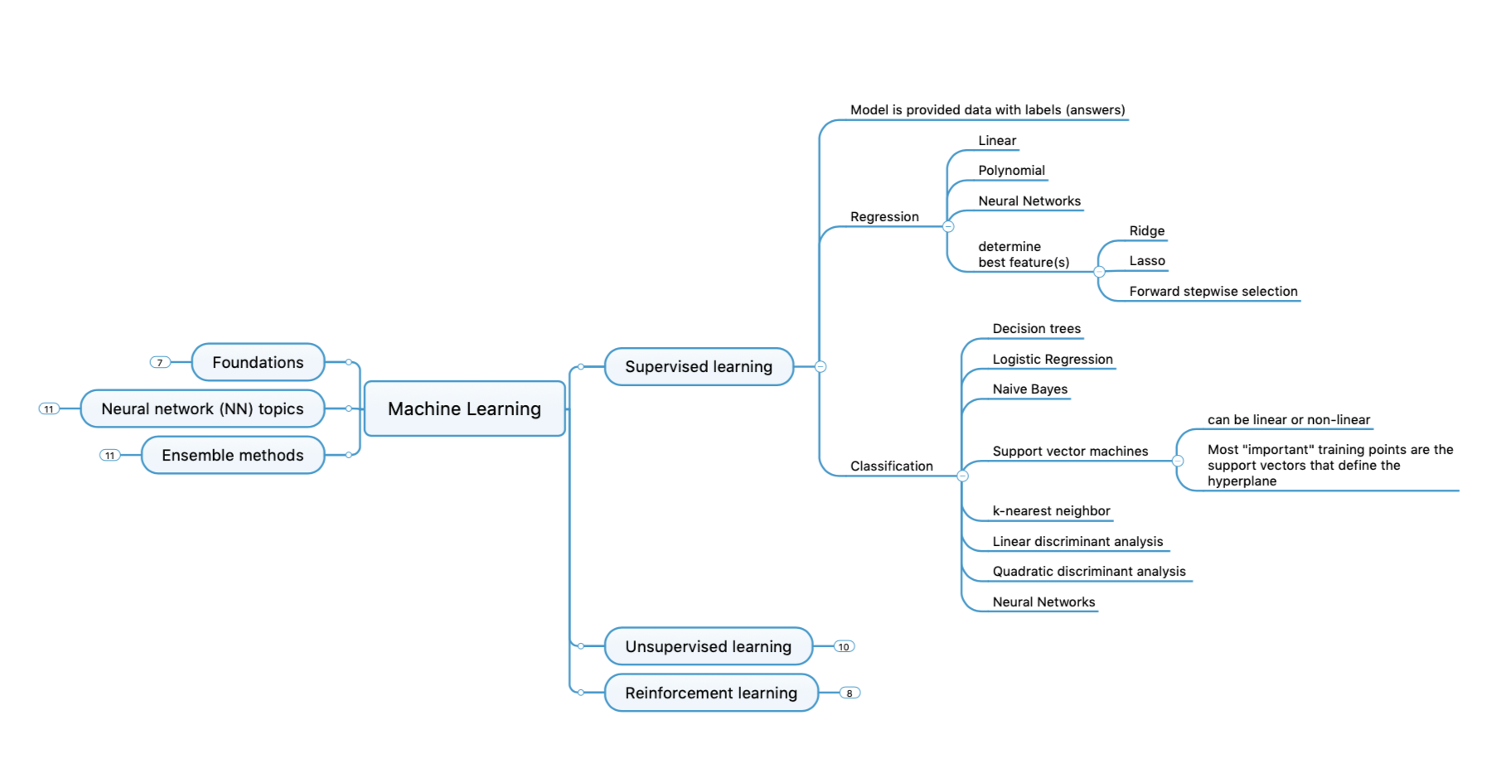
Concept Map - Detailed

Slide 6
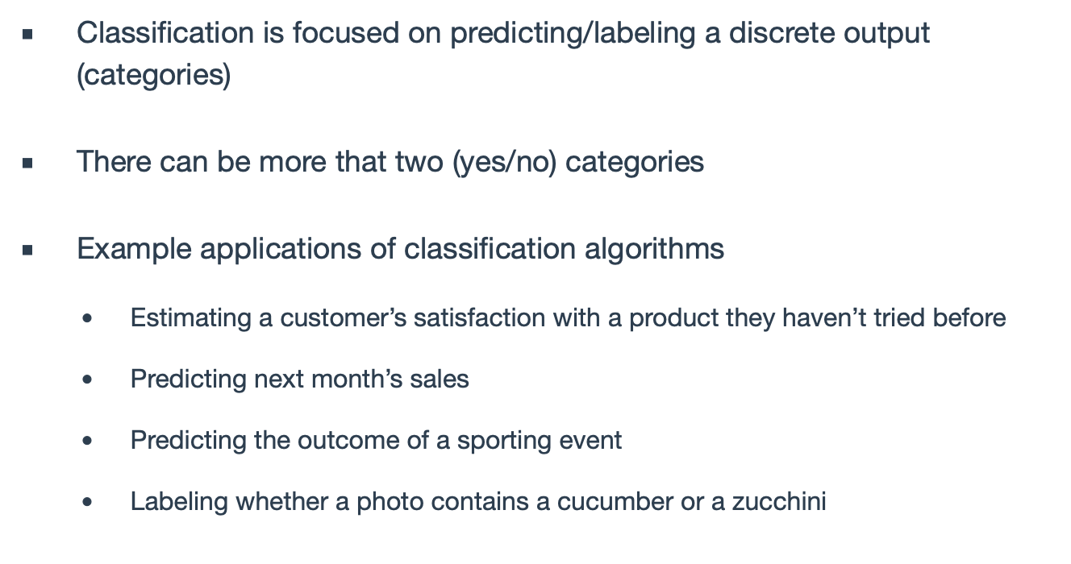
Categorical Problems

Slide 7
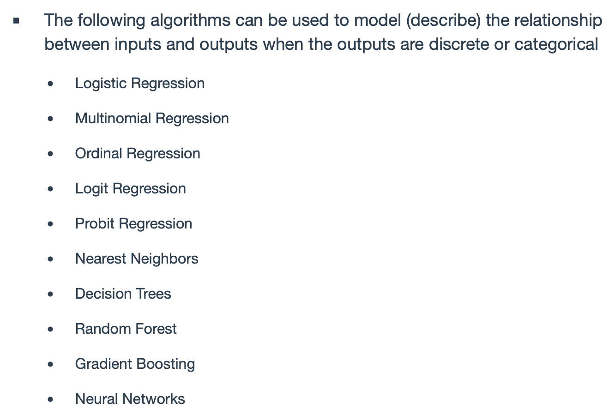
Categorical Problems
Linear Discriminant Analysis
Quadratic Discriminant Analysis

Slide 8
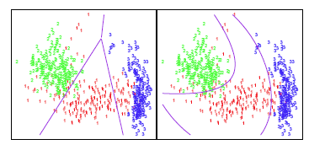
Overview
Big Picture
Classification Fundamentals
Logistic Regression
Linear Discriminant Analysis
Quadratic Discriminant Analysis
Error
Model Building with Python Examples
Logistic
LDA
QDA

Slide 9
Classification
Recall that in the regression problem our goal is to estimate the (real) number based on observed features
Output Type = Cardinal
Classification: Estimating the category (class) to which something belongs
Classes often have no direct underlying numerical relationship but we might use numbers as output values
Output Type = Nominal
Example: Tank = 1, Non-Tank = 0
Slide from Dr. Brett Borghetti, AFIT/ENG CSCE 623 Statistical Machine Learning course, 2019SP

Slide 10
Orange Juice Classification Example
Goal: predict what customers will buy: Citrus Hill orange juice or Minute Maid orange juice (based on their brand loyalty to various juice types)
Y (Purchase) is categorical: 0 (no) or 1 (yes)
X (LoyalCH) numerical (between 0 and 1) which specifies how loyal customers are to the Citrus Hill (CH) brand (0 = not loyal… 1 = completely loyal)
Could we use Linear Regression when Y is categorical?
Slide from Dr. Brett Borghetti, AFIT/ENG CSCE 623 Statistical Machine Learning course, 2019SP

Slide 11
Why not use Linear Regression For category estimation?
Regression forms a line…
0.9
How do we interpret values greater than 1?
0.7
Purchase
0.5
0.4
0.2
How do we interpret values of Y between 0 and 1?
0.0
.0
.1
.2
.3
.4
.5
.6
.7
.8
.9
1.0
LoyalCH
Slide from Dr. Brett Borghetti, AFIT/ENG CSCE 623 Statistical Machine Learning course, 2019SP

Slide 12
Classification Example 2: Credit Card Default Data
We would like to be able to predict customers that are likely to default (not pay off their card)
Possible X variables are:
Annual Income
Monthly credit card balance
The Y variable (Default) is categorical: Yes or No
How do we check the relationship between Y and X?
Slide from Dr. Brett Borghetti, AFIT/ENG CSCE 623 Statistical Machine Learning course, 2019SP

Slide 13
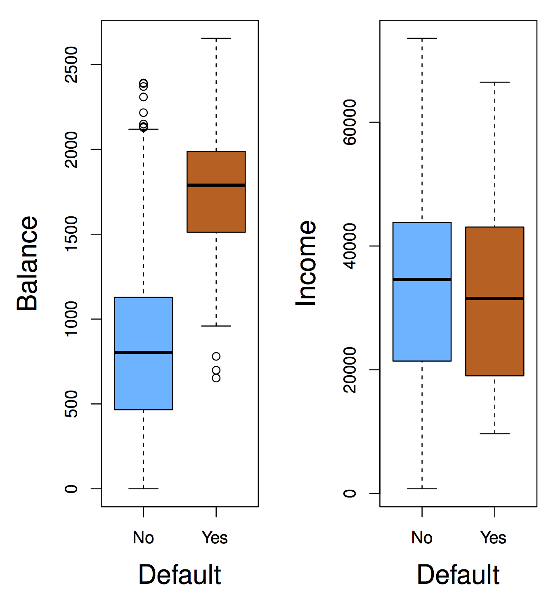
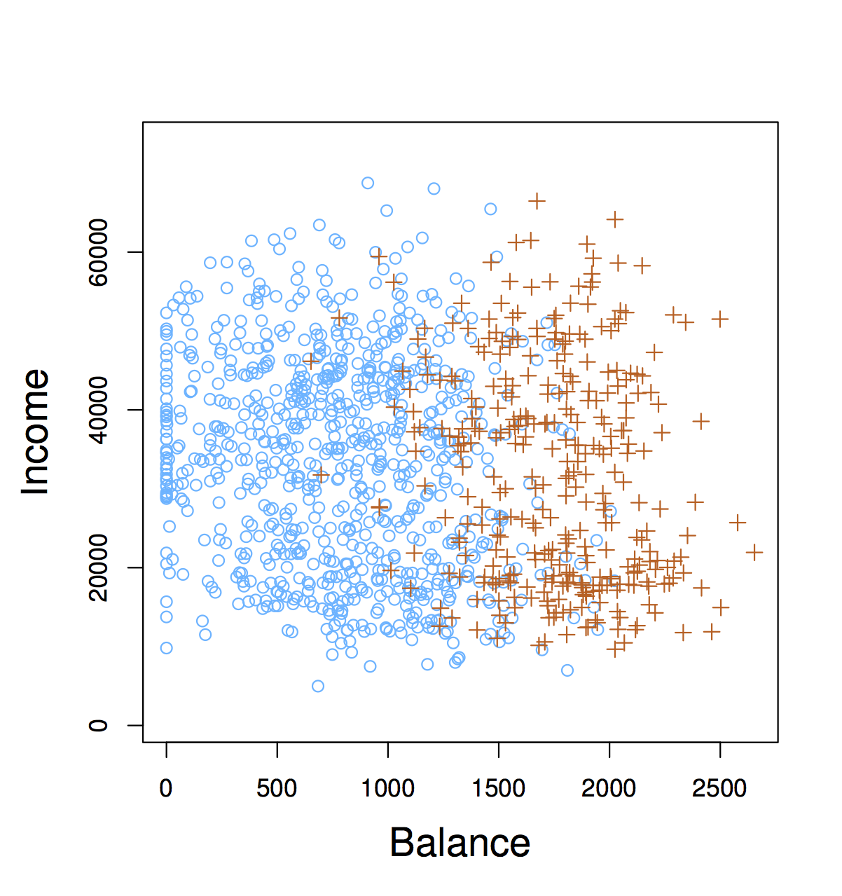
Exploring the (credit card) Default Dataset
Concept Check:
Is there a meaningful relationship between Balance and Defaulting?
Is there a meaningful relationship between Income and defaulting?
Slide from Dr. Brett Borghetti, AFIT/ENG CSCE 623 Statistical Machine Learning course, 2019SP

Slide 14
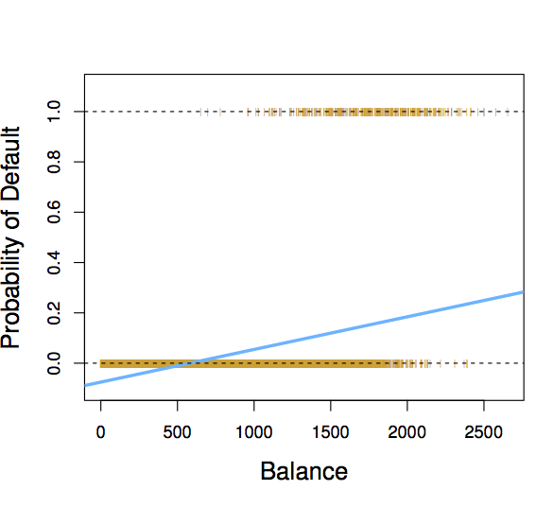
Why not Linear Regression?
For very low balances we predict a negative probability
For high balances we predict a probability above 1
When Balance < 500, Pr(default) is negative!
Slide from Dr. Brett Borghetti, AFIT/ENG CSCE 623 Statistical Machine Learning course, 2019SP

Slide 15
Solution: Use Logistic Function
Instead of trying to predict Y, let’s try to predict P(Y = 1), i.e., the probability a customer buys Citrus Hill (CH) juice.
Model P(Y = 1) with a function that gives outputs between 0 and 1.
Determine the Boolean answer by thresholding p
Logistic function: Logistic Regression
X₁
Slide from Dr. Brett Borghetti, AFIT/ENG CSCE 623 Statistical Machine Learning course, 2019SP

Slide 16
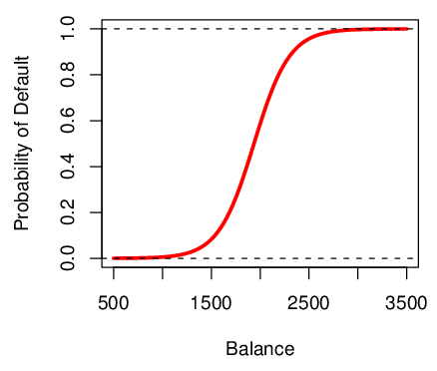
Logistic Function on Bank Default Data
The probability of default is close to, but not less than zero for low balances.
… and close to, but not above 1 for high balances
Slide from Dr. Brett Borghetti, AFIT/ENG CSCE 623 Statistical Machine Learning course, 2019SP

Slide 17
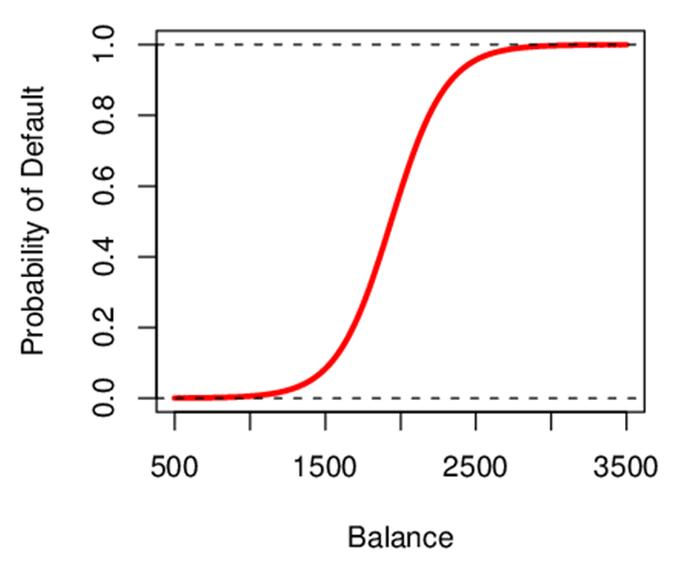
Interpreting β₁
Interpreting what β₁ means is not very easy with logistic regression, simply because we are predicting P(Y) and not Y
If β₁ =0, no relationship between Y and X
If β₁ >0, when X gets larger Y approaches 1
If β₁ <0, when X gets larger Y approaches 0
But how much bigger or smaller depends on where we are on the slope
Concept Check:
How is the logistic line altered by changing β₀ ?
Slide from Dr. Brett Borghetti, AFIT/ENG CSCE 623 Statistical Machine Learning course, 2019SP

Slide 18
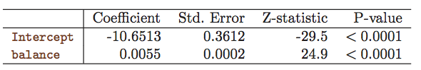
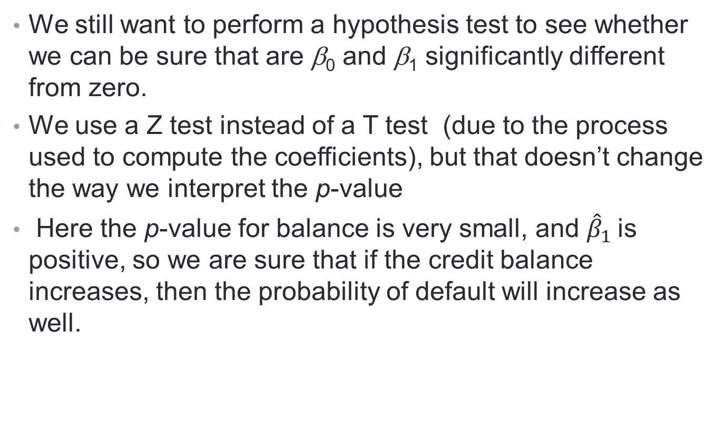
Logistic Regression Assessment: Are the coefficients significant?
We still want to perform a hypothesis test to see whether we can be sure that are β₀ and β₁ significantly different from zero.
We use a Z test instead of a T test (due to the process used to compute the coefficients), but that doesn’t change the way we interpret the p-value
Here the p-value for balance is very small, and ${\hat{β}}_{1}$ is positive, so we are sure that if the credit balance increases, then the probability of default will increase as well.
Slide from Dr. Brett Borghetti, AFIT/ENG CSCE 623 Statistical Machine Learning course, 2019SP

Slide 19
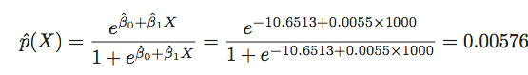
Logistic Regression Making Predictions
Suppose an individual has an average balance of $1000. What is their probability of default?
The predicted probability of default for an individual with a balance of $1000 is less than 1%.
For a balance of $2000, the probability is much higher, and equals to 0.586 (58.6%).
Slide from Dr. Brett Borghetti, AFIT/ENG CSCE 623 Statistical Machine Learning course, 2019SP

Slide 20
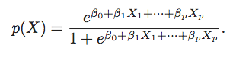
Multiple Feature Logistic Regression
We can fit multiple logistic regression coefficients
Slide from Dr. Brett Borghetti, AFIT/ENG CSCE 623 Statistical Machine Learning course, 2019SP

Slide 21
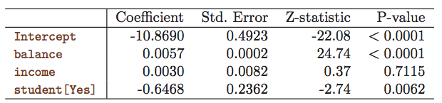
Multiple Feature Logistic Regression Credit Card Default Data
Predict Default using:
Balance (quantitative)
Income (quantitative)
Student (qualitative)
Slide from Dr. Brett Borghetti, AFIT/ENG CSCE 623 Statistical Machine Learning course, 2019SP

Slide 22
Linear Discriminant Analysis (LDA) & Quadratic Discriminant Analysis (QDA)

Slide 23
Linear Discriminant Analysis
Goal: Classify observations
Will a consumer buy a product or not?
Will a customer be satisfied or not?
Which candidate will a voter vote for?
LDA Key intuition:
Represent each class as a simple distribution with parameters
Predict the class of a new observation by which class distribution has the highest probability at that observation’s feature values
Slide from Dr. Brett Borghetti, AFIT/ENG CSCE 623 Statistical Machine Learning course, 2019SP

Slide 24
Assumptions of LDA
The observations are an unbiased random sample (i.i.d.) of the population
Each predictor variable is normally distributed
All classes share common (co)variance parameters
In Quadratic Discrimiant Analysis (QDA), classes may have different (co)variance parameters
Slide from Dr. Brett Borghetti, AFIT/ENG CSCE 623 Statistical Machine Learning course, 2019SP

Slide 25
Why not Logistic Regression?
Logistic regression parameter values are unstable when the classes are well separated
In the case where n is small, and the distribution of predictors X is approximately normal, then LDA is more stable than Logistic Regression
LDA is also more popular than logistic regression when there are more than two response classes
Slide from Dr. Brett Borghetti, AFIT/ENG CSCE 623 Statistical Machine Learning course, 2019SP

Slide 26
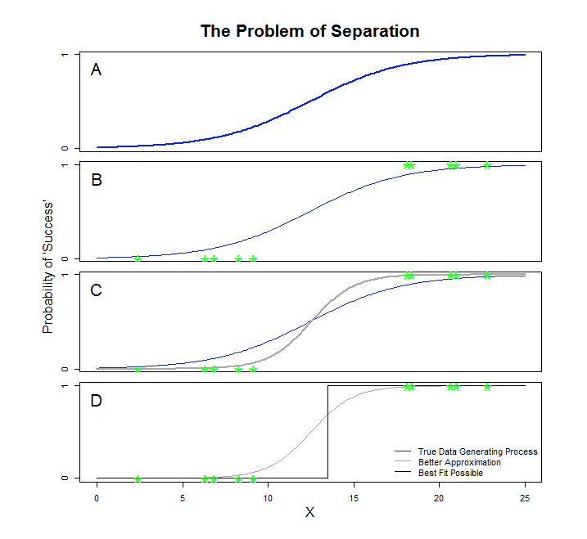
Instability in Logistic Regression

Slide 27
Apply LDA
LDA assumes that each class has a normal distribution with one mean per class but the same variance for every class
The key variables are estimated from the training data
Bayes’ theorem is used to compute p_{k} and the observation is assigned to the class with the maximum probability among all K probabilities
Slide from Dr. Brett Borghetti, AFIT/ENG CSCE 623 Statistical Machine Learning course, 2019SP

Slide 28
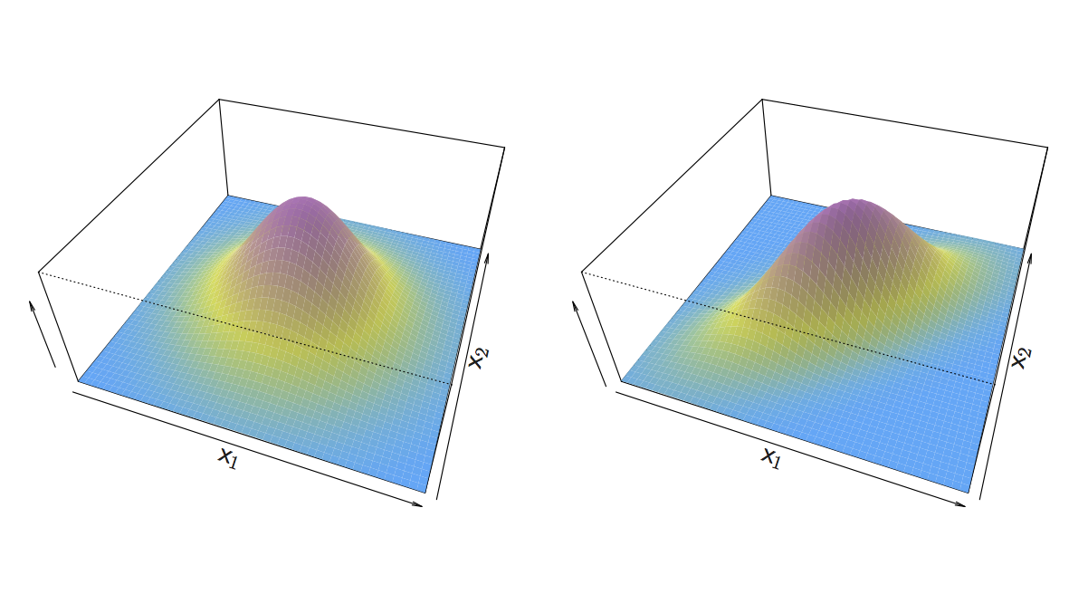
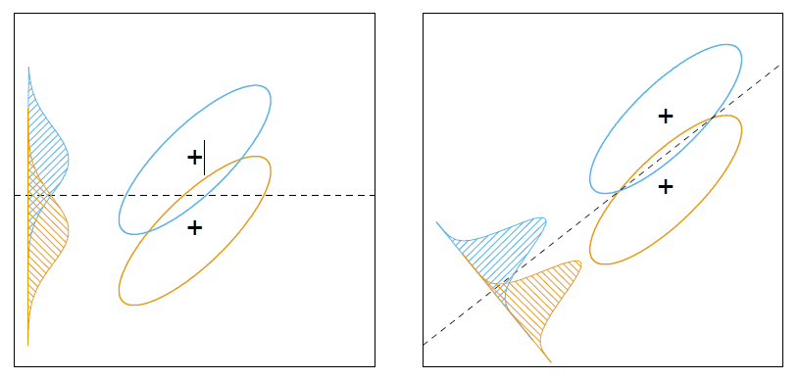
LDA intuition (more than 1 feature)
If X is multidimensional (p > 1), we use exactly the same approach except the density function f(x) is modeled using the multivariate normal density
Need to find the direction for which a projection into fewer dimensions yields the most information for discrimination of the LDA (Bayes-like) classifier using Covariance
Slide from Dr. Brett Borghetti, AFIT/ENG CSCE 623 Statistical Machine Learning course, 2019SP
Elements of Statistical Learning – Figure 4.9

Slide 29
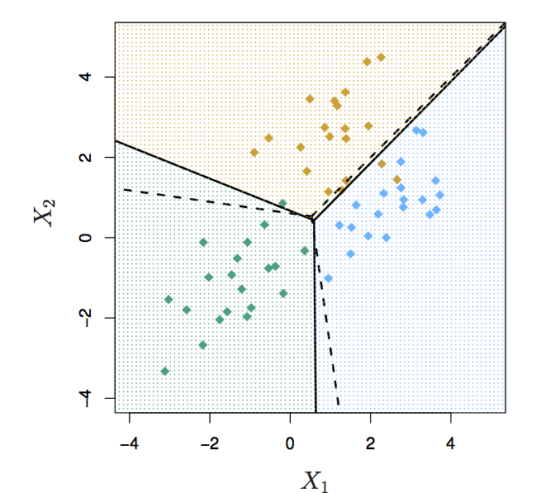
Multiclass LDA
Three classes & Two predictors (p =2)
20 observations were generated from each class
The dashed lines are Bayes’ boundaries
The solid lines are LDA boundaries
Slide from Dr. Brett Borghetti, AFIT/ENG CSCE 623 Statistical Machine Learning course, 2019SP

Slide 30
Linear Discriminant Analysis (LDA) & Quadratic Discriminant Analysis (QDA)

Slide 31
Quadratic Discriminant Analysis (QDA)
LDA assumed that every class has the same variance/ covariance
However, LDA may perform poorly if this assumption is far from true
QDA works identically as LDA except that it estimates separate variances/ covariance for each class
Slide from Dr. Brett Borghetti, AFIT/ENG CSCE 623 Statistical Machine Learning course, 2019SP

Slide 32
Which is better? LDA or QDA?
Since QDA allows for different variances among classes, the resulting boundaries become quadratic
Which approach is better: LDA or QDA?
QDA may work better when the variances are very different between classes and we have enough observations to accurately estimate the variances
LDA may work better when the variances are similar among classes or we don’t have enough data to accurately estimate the true differences in the variances
Slide from Dr. Brett Borghetti, AFIT/ENG CSCE 623 Statistical Machine Learning course, 2019SP

Slide 33
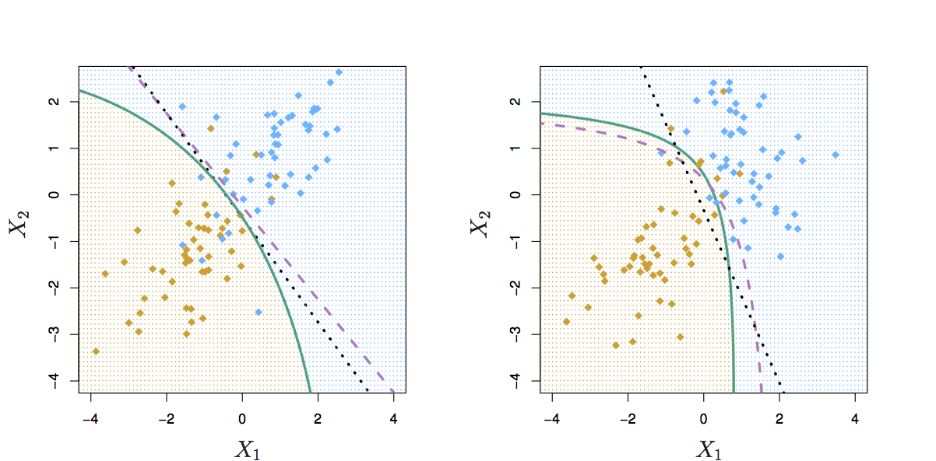
Comparing LDA to QDA
Black dotted: LDA boundary
Purple dashed: Bayes’ boundary
Green solid: QDA boundary
Left: variances of the classes are equal (LDA is better fit)
Right: variances of the classes are not equal (QDA is better fit)
Slide from Dr. Brett Borghetti, AFIT/ENG CSCE 623 Statistical Machine Learning course, 2019SP

Slide 34
Overview
Big Picture
Classification Fundamentals
Logistic Regression
Linear Discriminant Analysis
Quadratic Discriminant Analysis
Error
Model Building with Python Examples

Slide 35
2-class Performance Measures
Altering the decision boundary
Confusion Matrix
ROC
Slide from Dr. Brett Borghetti, AFIT/ENG CSCE 623 Statistical Machine Learning course, 2019SP

Slide 36
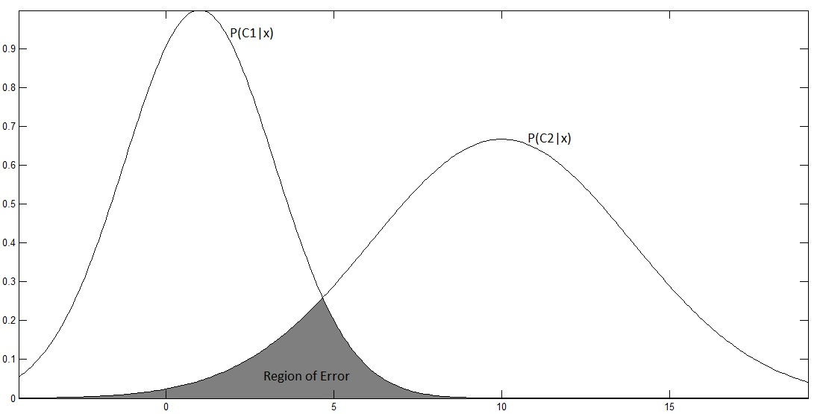
Altering the decision boundary
Sometimes the (approximate) Bayes decision boundary may not be adequate for the business case
?
?
?
Slide from Dr. Brett Borghetti, AFIT/ENG CSCE 623 Statistical Machine Learning course, 2019SP

Slide 37
Confusion Matrix
https://dzone.com/articles/understanding-the-confusion-matrix

Slide 38
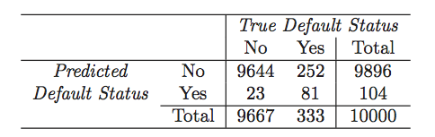
Classifier performance on Default Data (at p(y|x) > 0.5 as Threshold for Default)
LDA makes 252+ 23 = 275 mistakes on 10000 predictions (2.75% misclassification error rate)
But LDA miss-predicts 252/333 = 75.5% of defaulters
We shouldn’t use 0.5 as threshold for predicting default if this will cost the bank a lot of money
Slide from Dr. Brett Borghetti, AFIT/ENG CSCE 623 Statistical Machine Learning course, 2019SP

Slide 39
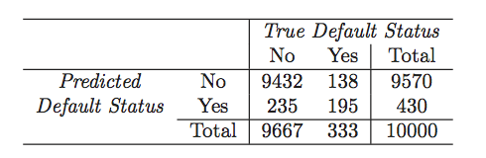
Use p(y|x) > 0.2 as Threshold for Default?
Now the total number of mistakes is 235+138 = 373 (3.73% misclassification error rate)
But we only miss-predicted 138/333 = 41.4% of defaulters
Slide from Dr. Brett Borghetti, AFIT/ENG CSCE 623 Statistical Machine Learning course, 2019SP

Slide 40
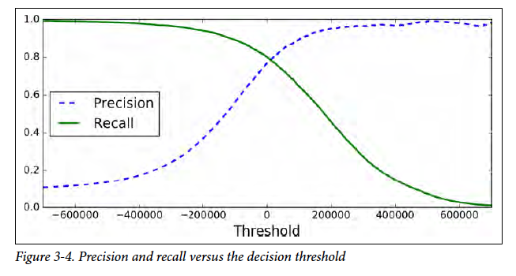
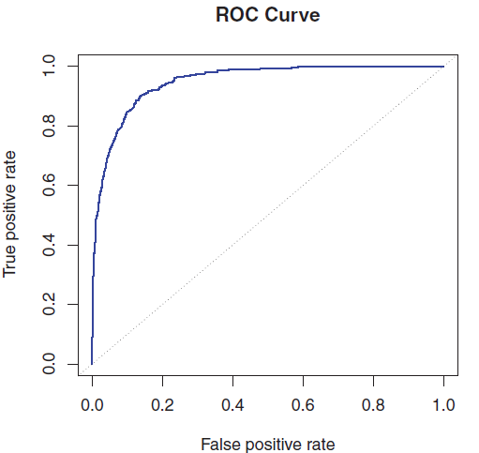
Precision vs. Recall, ROC
Precision vs. Recall
Receiver operating characteristic
Slide from Dr. Brett Borghetti, AFIT/ENG CSCE 623 Statistical Machine Learning course, 2019SP

Slide 41
Comparison of Classification Methods
KNN (Chapter 2)
Logistic Regression (Chapter 4)
LDA (Chapter 4)
QDA (Chapter 4)

Slide 42
Logistic Regression vs. LDA
Similarity: Both Logistic Regression and LDA produce linear boundaries
Difference: LDA assumes that the observations are drawn from the normal distribution with common variance in each class, while logistic regression does not have this assumption.
LDA would do better than Logistic Regression if the assumption of normality holds,
otherwise logistic regression can outperform LDA
Slide from Dr. Brett Borghetti, AFIT/ENG CSCE 623 Statistical Machine Learning course, 2019SP

Slide 43
KNN vs. (LDA and Logistic Regression)
KNN takes a completely different approach
KNN is completely non-parametric: No assumptions are made about the shape of the decision boundary
Advantage of KNN: We can expect KNN to dominate both LDA and Logistic Regression when the decision boundary is highly non-linear
Disadvantage of KNN: KNN does not tell us which predictors are important (no table of coefficients)
Slide from Dr. Brett Borghetti, AFIT/ENG CSCE 623 Statistical Machine Learning course, 2019SP

Slide 44
QDA vs. (LDA, Logistic Regression, and KNN)
QDA is a higher variance parametric model which offers a compromise in performance between non-parametric KNN method and linear methods such as LDA and logistic regression
If the true decision boundary is:
Linear: LDA and Logistic outperforms
Moderately Non-linear: QDA outperforms
More complicated: KNN is superior
Slide from Dr. Brett Borghetti, AFIT/ENG CSCE 623 Statistical Machine Learning course, 2019SP

Slide 45
Error Rate Comparison
Linear data
Non-linear data

Slide 46
Overview
Big Picture
Classification Fundamentals
Logistic Regression
Linear Discriminant Analysis
Quadratic Discriminant Analysis
Error
Model Building with Python Example

